Slide 1


Strengthening Global Reporting Frameworks in GCCs Through CA Leadership
Jangoo Dalal
CEO & Co-Founder

Slide 2


What Comes to Mind When You Think of a CA?
MOST OFTEN
P & Ls
Balance Sheets
Audit & Assurance
Compliance & Controls
Regulations & Risk
Tax
VACA?

Slide 3






The GCC Opportunity
The Evolving GCC Paradigm
Beyond Financials
CA’s Role in Driving GCC Growth

Slide 4

The GCC Opportunity Multiple
Impact Type | Value (approx.) | Multiplier vs Direct
Direct Output | USD 76 billion | —
Total Output | USD 241 billion | ≈ 3×
Direct GVA | USD 68 billion | —
Total GVA | USD 182 billion | ≈ 2.7×
Direct Employment | 2.1 million jobs | —
Total Jobs Supported | 10.4 million jobs | ≈ 5×
Every CA involved with a GCC can accentuate this multiplier—beyond internal finance and governance, they can help shape hiring, consumption, real estate, education, retail, and more.

Slide 5

The Evolving GCC Paradigm
Multi-jurisdiction compliance (IFRS, US GAAP, IndAS)
Technology-enabled reporting (AI, blockchain, automation)
Performance Measurement beyond Financial Metrics -- ESG
Global convergence of Financial + ESG standards (ISSB, CSRD, SEBI BRSR).

Slide 6
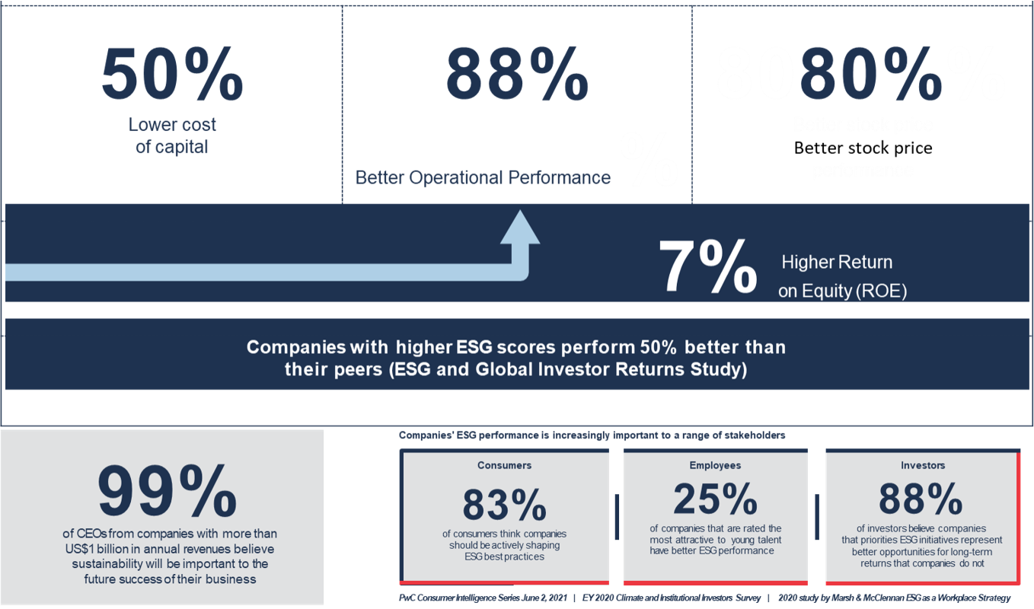
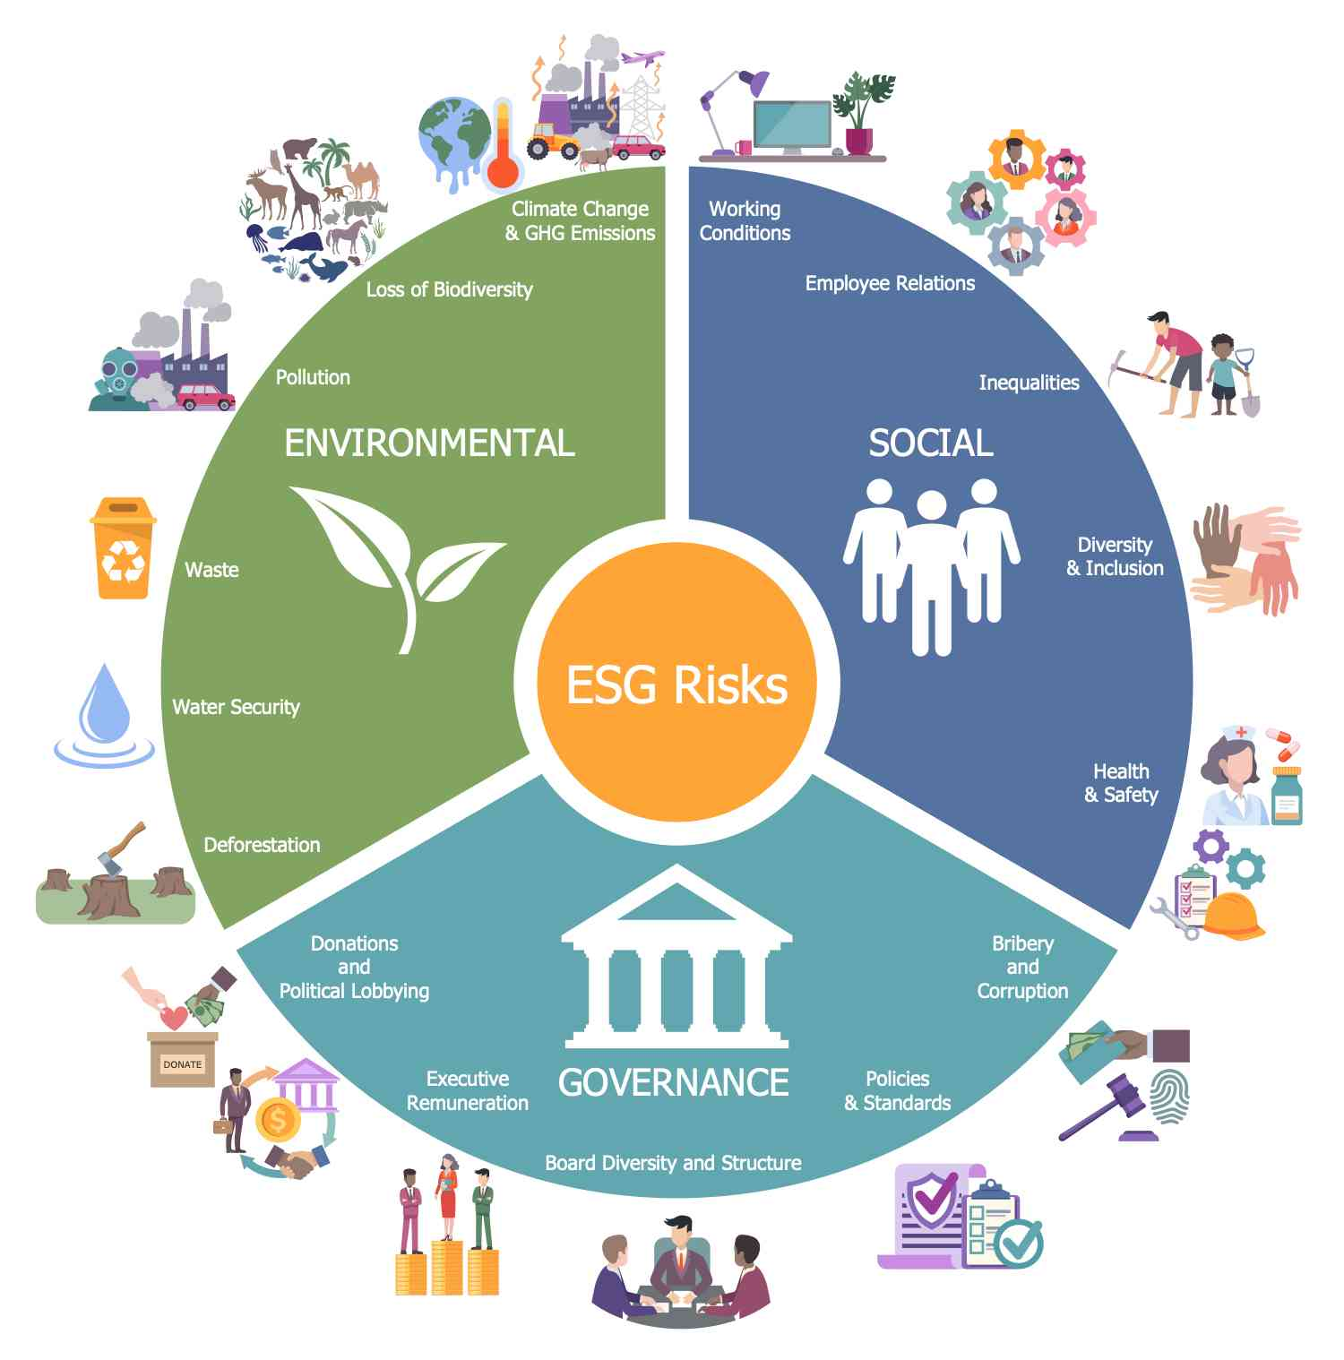
ESG: The New Language of Business
UN Global Compact Study: Good to Have → Must Have

Slide 7

















ESG: The New Language of Business
From Good to Have → Must Have
For the GCC Industry, ESG means:
Efficient use of Resources: Human, Energy, Space, Water
High Social & Governance Standards
Ensuring Highly Productive & Safe workplaces
Building trust with regulators & communities
Global Frameworks- based ESG Reporting
Meeting global customer expectations

Slide 8
The CA’s Role in Driving GCC Growth
Beyond financials: ESG and Sustainability
  The world no longer looks at profit alone
  Investors, regulators, and consumers demand disclosures on carbon, diversity, human rights
  ISSB standards, European CSRD, SEBI’s BRSR mandate—all signal a new age of Integrated Reporting
  Who better than CAs, trained in rigour, ethics, and assurance, to lead this?
Technology as a Partner, Not a Threat
  AI will automate reconciliations, anomaly detection, and even parts of the audit
  But judgment, ethics, governance—these cannot be coded
  CA leaders must embrace AI as an enabler to deliver faster, deeper, more reliable insights.
Risk, Governance, and Trust
  In a digital-first world, risk is no longer limited to balance sheets.
  Data privacy, cyber risk, ethical AI, Greenwashing—all of these require CA oversight and Guidance
  Your role is not just to prevent failure—it is to guide organisations to sustainable success.

Slide 9

Call To Action
Creating a Single Version of Truth across geographies
Designing robust Controls and Processes that stand global scrutiny
Embrace ESG and Sustainability as core to Value Accretion & Reporting
Governance, Risk management, and Assurance readiness –BEYOND FINANCIAL METRICs
Leverage Technology not as competition but as collaboration.

Slide 10
Finally
Trust is the ultimate currency of business.
And CAs are its strongest guardians.
VACA = Value Accreting Chartered Accountant
Agree?

Slide 11

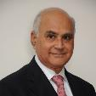

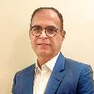
Introduction & Credentials
GovEVA is your Sustainability Sherpa-guiding your sustainability
journey with cutting-edge technology and deep sustainability expertise.
From materiality to reporting, we digitize the entire ESG lifecycle,
ensuring accuracy, compliance, and real-time insights.
Partner with us to navigate complex ESG challenges and accelerate
your path to responsible, future-ready growth.
Mr. Shailesh V. Haribhakti
Co-Founder & Mentor, Board Leader, Chartered Accountant, ESG & Governance Visionary, Author
Mr. G. N. Bajpai
Co-Founder & Mentor
(Ex-Chairman, SEBI & LIC)
Founding Team
Jangoo Dalal
Co-Founder & CEO
EX-MD Cisco, Avaya, DlInk
50+ years’ experience Corporate Governance,
Capital Markets, Insurance Reforms Board Leadership, ESG
Oversight, Regulatory Transformation Board Member/Chairman, Government Committees
40+ years’ experience Chartered Accountant, Corporate Boards,
Sustainability Strategy, Audit & Risk Oversight Board Member/Chairman, Government Task Forces
30+ years’ experience,
Technology & GCC Leadership, ESG Strategy, Corporate Governance, Product Marketing, Board Effectiveness, and Sustainable Digital Transformation
Global Experience

Slide 12




Jangoo Dalal
Co-founder & CEO
Contact
+91 98208 64343
Jangoo.Dalal@goveva.com
www.goveva.com

