Slide 1

Unlocking Growth Potential in GCC:
The Role of Funding and Investment Incentives
An overview of India's maturing GCC ecosystem and the transformative role of policy, funding, and talent in driving the next wave of growth
Presented by: CA Abhinav Goel
ICAI GCC Summit, Hyderabad | October 2025
October 8, 2025

Slide 2
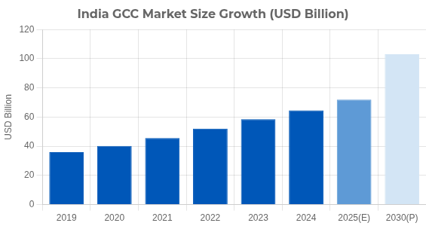
India's GCC Landscape: Market Size & Growth
Over 1,800 GCCs in India (2024), representing 17% of global GCC footprint
1.9 million professionals employed, projected to reach 2.5-2.8 million by 2030
Market size: USD 64.6 billion (FY24), growing at 9.8% CAGR; expected to reach USD 100+ billion by 2030
Major hubs: Bengaluru, Hyderabad, Pune, Chennai — with increasing presence in tier-2/3 cities (7% of GCCs, up from 5% in 2019)
Evolution from cost centers to strategic innovation hubs driving digital transformation, AI adoption, and product development
Source: Nasscom-Zinnov India GCC Landscape Report 2024
1

Slide 3
Why Government Must Lead: Global GCC Competition
Rising global competition: Eastern Europe (Poland, Hungary), Southeast Asia (Philippines, Vietnam), and Latin America (Mexico, Costa Rica) offer attractive alternatives with competitive costs and growing tech talent
How Competitors Are Gaining Ground
EASTERN EUROPE
EAST ASIA
Policy agility is critical: Global MNCs rapidly shift operations to jurisdictions with stable, predictable, and incentive-rich environments
Rising Competitor
Tech Specialist
EU proximity
INDIA
Advanced infrastructure
Strong STEM talent
Current Leader
1,800+ GCCs
LATIN AMERICA
$64.6B market
India's advantages under threat: Despite leadership in talent depth and established ecosystem, competitors are implementing aggressive incentive packages and regulatory reforms
Emerging Player
SOUTHEAST ASIA
US timezone alignment
Growing Alternative
Bilingual talent
Cost advantage
Government support
Economic security imperatives: GCCs contribute 1.5% to India's GDP, with potential to reach 2.5% by 2030—requiring strategic government action to secure this growth
India must maintain momentum: Without proactive policy intervention across states, India risks losing its position as the preferred global GCC destination
Source: Analysis based on NASSCOM reports, World Economic Forum data, and EY Global GCC Trends 2024-2025
2

Slide 4
Evolving Policy Framework: Union Budget 2025
Union Budget 2025 marks a significant shift: GCCs now a national strategic priority for India
National Framework for GCCs introduced to guide states, especially for tier-2/3 city expansion
Financial Incentives
Rental reimbursements, capital subsidies, payroll support, and skilling grants for tier-2/3 city GCCs
Key objectives: Accelerate digital transformation, drive inclusive job growth, enable stable regulatory structure
Tax Benefits
Simplified transfer pricing rules: Block TP assessments and expanded safe harbor provisions
Preferential tax rates in SEZs/STPs, reduced corporate tax for new GCCs, indirect tax exemptions
PPP-led infrastructure development with innovation labs and R&D funding access
Operational Support
Why now? Global competition from Eastern Europe to Southeast Asia requires policy support to maintain India's position
Single-window clearance, fast-track approvals, dedicated GCC helpdesks at state level
Source: Union Budget 2025-26, MoF, Government of India
3

Slide 5

Best Practices: State-Level Policy Frameworks in India
Karnataka: First mover with dedicated GCC policy (2024-29), "Beyond Bengaluru" initiative, ₹100 crore innovation fund, cluster seed funding, 50% rental/EPF reimbursements
Policy Component
KA
TG
GJ
MH
UP
Dedicated GCC Policy
Draft
Telangana: Digital innovation focus, 24-hour approval window, deep academia-industry partnerships, startup ecosystem integration
Tier-2/3 City Focus
Rental Subsidies
50%
30%
25%
40%
35%
Gujarat: Streamlined land allotment, sector-specific incentives, plug-and-play infrastructure, integrated innovation districts
Academia Integration
Skilling Support
20%
25%
15%
15%
30%
Maharashtra: Payroll subsidies up to 50%, coworking support, startup ecosystem grants, export promotion focus
Single Window Clearance
Uttar Pradesh: Emerging tech city focus, security-aligned economic strategy, talent development pipeline, single-window clearance
Innovation Fund
₹100cr
₹75cr
₹50cr
₹60cr
₹45cr
KA: Karnataka
TG: Telangana
GJ: Gujarat
MH: Maharashtra
UP: Uttar Pradesh
Source: State GCC policies, NASSCOM reports, EY India GCC Survey 2024
4

Slide 6
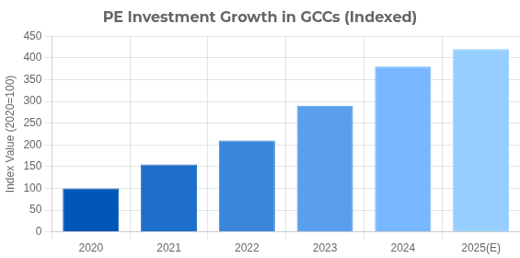
Private Equity: A Growth Accelerator
PE investment in GCCs has quadrupled over the past five years
1 in 3 mid-market GCCs established recently is PE-backed
PE-backed GCCs account for 65% of mid-market facilities established in the last four years
Key investors include KKR, Blackstone, Warburg Pincus, Apollo, BlackRock and Ares
PE-backed GCCs drive rapid transformation with compressed timelines and direct CXO reporting
Leading sectors: SaaS, cloud, IT security, BFSI, analytics, and healthcare/life sciences
Lumina CloudInfra (Blackstone)
CDK Global (Brookfield)
Blackstone-backed Lumina CloudInfra rapidly established a strategic GCC in India to accelerate its data center technology innovation and platform development. The GCC has become a critical driver for Lumina's Asia expansion strategy.
After Brookfield's acquisition, CDK Global established a GCC in India that transformed from a back-office operation to a core innovation hub, delivering substantial EBITDA improvement and accelerated product development cycles.
KKR
Blackstone
Warburg
Apollo
BlackRock
Source: ANSR Research, Zinnov, Economic Times 2025
5

Slide 7
Best Practices: Leveraging Incentives for GCC Growth
Strategic Location Selection
Locate in SEZs/STPs for maximum tax advantages and simplified compliance processes
1
Evaluate SEZs, STPs, and emerging hubs for optimal tax benefits and talent access
Apply for state-specific incentives: rental subsidies, EPF contributions, R&D grants based on policy availability
Incentive Mapping & Application
2
Match operations with central and state incentives; apply for multiple compatible schemes
Engage with local ecosystem partners for talent skilling initiatives and innovation collaborations
Utilize safe harbour provisions and block transfer pricing assessments for cross-border tax predictability
Compliance & Documentation
3
Establish robust systems for transfer pricing, tax filing, and incentive tracking
Consider tier-2/3 city expansion to access untapped talent pools and maximize location-based incentives
Establish PPP models to leverage government-supported innovation labs and digital infrastructure
Ecosystem Integration
4
Form partnerships with academia, startups, and government innovation programs
Source: Industry best practices based on GCC performance studies 2024-25
Outcome Measurement
5
Track ROI on incentive utilization and adjust strategy to maximize benefits
6

Slide 8
Finance Careers in the GCC Ecosystem
High demand expertise: Compliance management, tax optimization, incentive frameworks, transfer pricing, and cross-border regulations
Incentive Program Manager
PE Portfolio Finance Lead
Emerging roles: Fund accounting specialists, value tracking analysts, transformation finance leads, partnership managers for PPP models, and M&A integration specialists
Navigates complex state/central incentive schemes, optimizes GCC benefit capture, and manages compliance
Tracks investment value creation, manages cross-border value flows, and drives transformation metrics
Growth areas: Tier-2/3 city GCCs (21% YoY hiring growth vs. 12% overall), PE-backed firms, and digital/AI-focused capabilities
TP & Tax Strategy Specialist
Innovation Finance Analyst
Implements safe harbor rules, block assessments, and optimizes cross-border financial structures
Manages R&D fund allocations, tracks innovation ROI, and supports grant applications
Key skills: Policy interpretation, incentive optimization, safe harbor/TP expertise, transformation project management, and quantitative analytics
Career paths: Finance transformation leads, incentive specialists, cross-border compliance experts, and strategic value officers
Source: Zinnov-Nasscom GCC Finance Talent Analysis 2024, Industry interviews
7

Slide 9




Practicing CAs: Unlocking Opportunities in the GCC Revolution
Surge in advisory demand: Tax structuring, compliance, transfer pricing, and R&D incentive advisory for new and expanding GCCs
Strategic services: Entry structuring, incentive application guidance, safe harbour navigation, multi-year TP audits, global mobility solutions
Transfer Pricing
Tax Advisory
Safe harbour consulting, documentation, APAs, dispute resolution
SEZ benefits, incentive optimization, tax planning
Compliance & assurance: GST & corporate tax filings, SEZ/STPI compliance documentation, payroll & subsidy tracking systems
New revenue streams: GCC policy consulting, partnering with state agencies for incentive implementation, digital transformation finance
Advisory
Compliance
Entry strategy, incentive applications, expansion planning
Multi-jurisdiction filings, regulatory reporting, audits
Growth areas: Tier-2/3 city expansions, PE-backed GCCs requiring rapid scale solutions, cross-border transactions
Source: Industry insights from CA firms serving the GCC ecosystem, 2025
8

Slide 10
Conclusion & Key Takeaways
India's GCCs are at a pivotal growth point: strong policy framework, robust investments, and increasing global relevance
Harness government incentives and private funding for both initial setup and long-term innovation
Finance leaders mastering policy, incentives, and cross-border investments will spearhead the next growth wave
Tier-2/3 expansion offers untapped potential with significant talent pools and state-specific incentives
Embrace the opportunity, drive innovation, create impact!
CA Abhinav Goel
Senior Vice President – GCC Capabilities, Quintes Global
+91 99101 70694
AbhinavG@QuintesGlobal.com
9

