Slide 1

4th Edition of Global Capability Center Summit
Navigating Borders: Taxation & Regulation in the GCC Evolution
Presented by CA Sharada Shetty
An authoritative examination of tax, transfer pricing, and regulatory frameworks shaping the future of Global Capability Centers operating across jurisdictions.

Slide 2
Agenda
01
02
03
Understanding GCCs
Growth & Market Dynamics
Typology of GCC
Definition, evolution, and current landscape of Global Capability Centers
Value attribution and functional analysis across GCC types
Statistical analysis and projections for the GCC ecosystem
04
05
Tax & Transfer Pricing
Strategic Pathways
Critical compliance challenges and OECD Pillar Two implications
Dispute resolution, incentives, and competitive positioning

Slide 3
What is a Global Capability Center?
Core Definition
Transformational Trends
A Global Capability Center (GCC) is a wholly-owned operational unit of a multinational enterprise that delivers specialized global services across strategic business functions. These centers have evolved far beyond traditional back-office support to become innovation engines and value creators.
The GCC landscape is undergoing fundamental transformation driven by strategic repositioning and technological advancement.
From Cost to Value
Service Delivery Domains
Shifting from cost arbitrage models to strategic value creation centers
Finance, Tax, and Risk Management
IP Ownership
Human Resources and Operations
Digital Transformation and Engineering
Assuming responsibility for intellectual property, innovation, and product development
Artificial Intelligence, Machine Learning, and Data Analytics
Research, Development, and Innovation
Leadership Hubs
Cybersecurity and Cloud Infrastructure
Emerging as global centers of excellence with senior leadership presence
Hybrid Models
Adopting flexible organizational structures combining multiple service lines

Slide 4
Evolution of GCCs in India (2018–2025)
The maturation of India's GCC ecosystem reflects a deliberate progression through distinct phases, each characterized by increasing sophistication and strategic value contribution.
Phase 1: Cost Arbitrage
Phase 3: Value Creation
Pre-2018
2020–2023
Primary focus on leveraging India's labor cost advantages for transactional support, shared services, and operational efficiency. Centers emphasized volume processing and standardized delivery models.
Expansion into digital engineering, advanced analytics, cybersecurity, and strategic technology functions. Centers began developing specialized capabilities and domain expertise.
1
2
3
4
Phase 2: Process Excellence
Phase 4: Innovation & Leadership
2018–2020
2023–2025
Emphasis shifted to workflow optimization, business process management maturity, and automation initiatives. Quality frameworks and continuous improvement methodologies became central to operations.
Emergence of AI/ML capabilities, product innovation ownership, and global technology leadership positioning. GCCs now drive strategic initiatives and own critical intellectual property.

Slide 5
GCC/GIC Evolution and Growth
India has established itself as the world's leading destination for Global Capability Centers, demonstrating extraordinary growth across all key metrics. The ecosystem's expansion reflects both quantitative scale and qualitative sophistication.
1,700+
2,975+
$64.6B
1.9M+
Global Capability Centers
Operating Units
Revenue Generated
Professionals Employed
Total installed operational units established by multinational enterprises, including satellite offices and specialized centers
Collective FY2024 earnings representing significant contribution to India's services export economy and GDP
Active centers operating across India as of FY2024, representing the world's largest concentration of multinational capability hubs
Highly skilled talent base working in Indian GCCs, spanning engineering, analytics, finance, and specialized domains

Slide 6

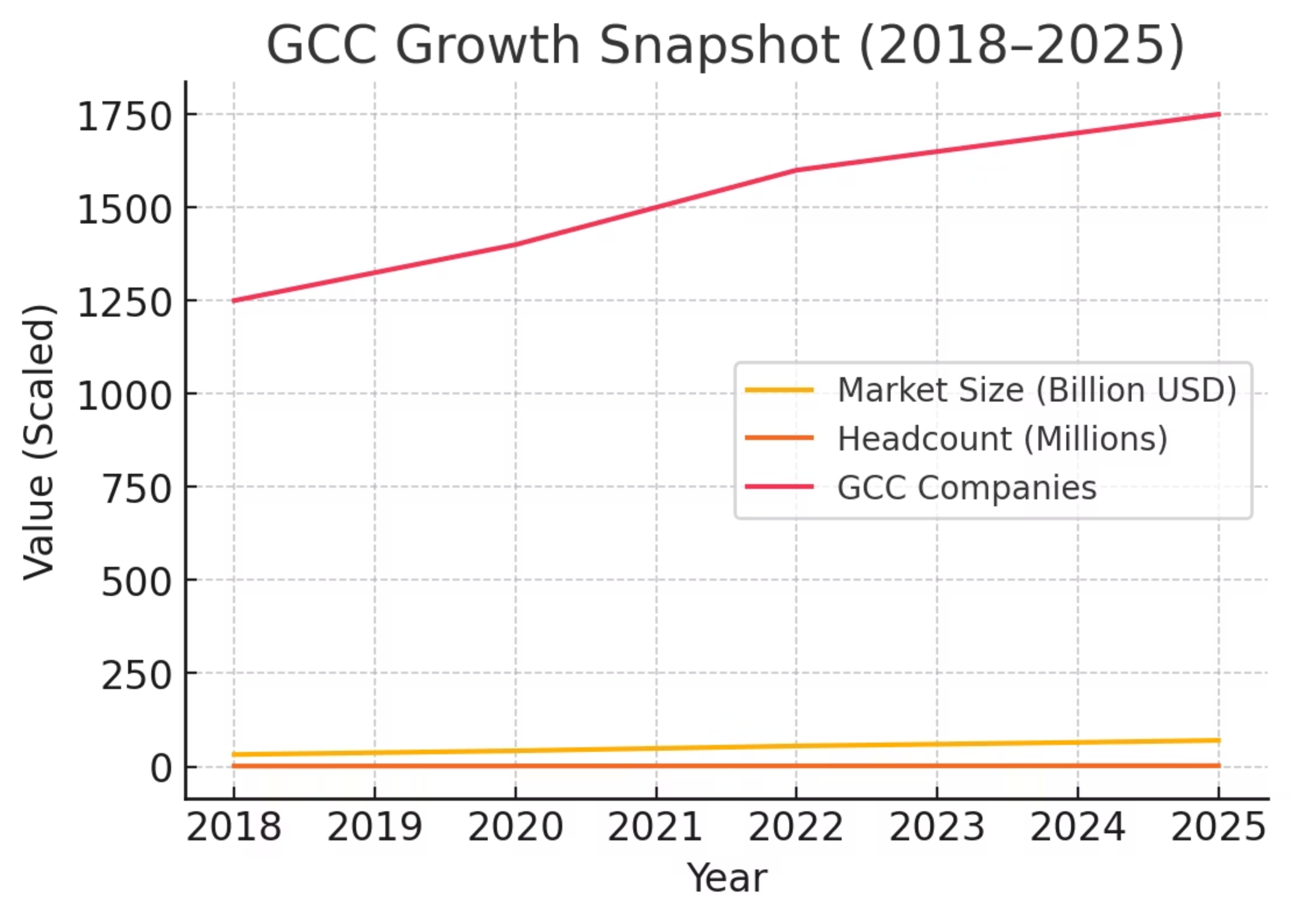
GCC Growth Snapshot (2018–2025)
A comprehensive view of the GCC ecosystem's evolution reveals consistent expansion across multiple dimensions, with particular acceleration in high-value service categories and tier-2 city penetration.
The data visualization captures year-over-year progression in key performance indicators including the number of operational centers, total professionals employed, aggregate revenue generation, and geographic distribution patterns. Notable inflection points include the 2020-2021 acceleration in digital transformation investments and the 2023-2024 surge in AI/ML center establishment.
This growth trajectory has created unprecedented complexity in transfer pricing compliance, as traditional cost-plus models increasingly fail to capture the economic value generated by these sophisticated operations. Tax authorities worldwide are scrutinizing GCC profit allocations with heightened intensity.

Slide 7





Evolution of GCC Model (2020–2030)
The fundamental architecture of Global Capability Centers is undergoing structural transformation, driven by technological advancement, strategic repositioning, and evolving multinational enterprise requirements.
Functional Transformation
Traditional back-office operations are evolving into shared services platforms, which are further advancing into digital innovation units with strategic mandates
Capability Expansion
Rapid growth in Engineering R&D, AI/ML development, and data engineering functions is fundamentally altering the value proposition of Indian centers
Leadership Migration
Senior leadership roles and strategic decision-making authority are increasingly concentrated in Indian operations rather than parent company headquarters
Geographic Diversification
Expansion beyond traditional metro hubs into Tier-2 cities including Pune, Coimbatore, Kochi, Jaipur, and Ahmedabad

Slide 8

GCC Growth Outlook
India's GCC ecosystem has demonstrated remarkable resilience and growth, establishing itself as the premier destination for global capability centers worldwide. The convergence of talent availability, cost competitiveness, technological infrastructure, and supportive policy frameworks has created a self-reinforcing growth dynamic.
1
2
3
Strong Historical Growth
Ambitious 2030 Outlook
Expanding Ecosystem
Between FY2019 and FY2024, Indian GCCs achieved a compound annual growth rate of approximately 9.8% in revenue, demonstrating consistent expansion despite global economic uncertainties, pandemic-related disruptions, and shifting geopolitical dynamics. This performance reflects the strategic importance multinational enterprises place on their Indian operations.
Industry projections indicate GCC revenue in India could expand to $99-105 billion by 2030, driven by increased sophistication of services delivered, expansion into higher-value functions, and the establishment of innovation-focused centers. This represents nearly doubling current revenue levels within six years.
The number of companies operating GCCs is expected to grow to 2,100-2,200 by 2030, employing approximately 2.5-2.8 million professionals. This expansion includes both new center establishments by companies entering the Indian market and capacity increases by existing operators deepening their presence.
The fundamental shift in GCC positioning—from cost-reduction delivery hubs to value-creation centers, innovation engines, and product/engineering leadership platforms—represents a strategic transformation with profound implications for taxation, transfer pricing methodologies, and regulatory compliance frameworks. The shift from IT-focused operations to AI/ER&D centers creates new challenges in value attribution and profit allocation.

Slide 9








GCC Value Creation Model
Contemporary GCCs have transcended their historical positioning as cost-reduction vehicles to become strategic value creators. This transformation fundamentally alters their transfer pricing characterization and tax risk profile.
High-Skill Digital Engineering
Enterprise AI & Analytics
Advanced software development, cloud architecture design, DevOps excellence, and infrastructure modernization requiring specialized technical expertise and creative problem-solving capabilities
Development of proprietary machine learning models, natural language processing systems, computer vision applications, and predictive analytics platforms that drive competitive advantage
Global Product Development
Cybersecurity & Cloud Operations
End-to-end ownership of product ideation, design, development, testing, and enhancement cycles for market-facing offerings and internal platforms
Enterprise-wide security operations centers, threat intelligence, incident response, cloud infrastructure management, and zero-trust architecture implementation

Slide 10
GCC Operating Models
GCC Models
Ownership
Control
Cost
Speed to Setup
Best For
BOT
Transfers eventually
Medium → High
Medium
Fast
Large enterprises entering new geography
ODC
Vendor
Medium
Low–Medium
Very fast
Product/Tech needing capacity
Captive
Client
High
Medium–High
Slow
Long-term strategic centers
Hybrid
Shared
Medium–High
Medium
Medium
Scaling while retaining control
Managed Captive
Client
High
Medium
Fast
Growing firms minimizing admin load
Virtual Captive
Vendor but dedicated
Medium–High
Medium
Fast
Mid-size, no entity setup
JV
Shared
Shared
Medium
Medium
Regulated or complex markets
GCC-as-a-Service
Vendor-provided
Medium
Low
Very fast
Startups & pilots
Distributed GCC
Client
High
Medium–High
Slow
Global risk diversification

Slide 11
Key Issues Facing GCC Setup in India
Despite impressive growth trajectories and strategic positioning, the GCC ecosystem confronts multifaceted challenges that require proactive management and strategic planning. These issues span talent acquisition, operational maturity, regulatory compliance, and competitive positioning.
Talent Availability & Capability
Regulatory & Operational Risks
While India maintains large talent pools, demand for next-generation skills—AI/ML specialists, product managers, high-end engineering talent—is creating significant pressure. Retention challenges, upskilling requirements, and leadership development represent material concerns for long-term sustainability.
Given accelerated growth, regulatory compliance, data privacy requirements, IP protection mechanisms, and global delivery risks are increasingly prominent. Concentration risk exists where GCCs are highly concentrated in limited cities or functions, creating potential disruption vulnerabilities.
Value-Gap / Maturity Gap
Geographic Diversification
Many GCCs still operate primarily as delivery and support centers rather than strategic innovation hubs. The transition to product ownership, strategic function leadership, and innovation mandates is ongoing. Bridging this "value gap" is essential for competitive positioning and value chain advancement.
Movement into Tier-2 and Tier-3 cities presents significant opportunities for cost optimization and talent access, but also challenges around infrastructure readiness, ecosystem maturity, and talent pipeline development in non-metro locations.
Competitive Pressure & Global Positioning
Innovation & Technology Adoption
As Indian GCCs evolve, they face intensifying global competition from alternative destinations including Poland, Philippines, and UAE. Centers must simultaneously maintain cost advantages, talent advantages, and deliver on higher-value strategic mandates.
While adoption of AI, ML, and engineering R&D is accelerating, converting technical capability into tangible enterprise value—beyond experimentation and proof-of-concept stages—remains a critical challenge requiring sustained investment and organizational change.

Slide 12
India Tax Landscape for GCCs
The Indian tax environment for Global Capability Centers is characterized by increasing sophistication in regulatory oversight, evolving transfer pricing frameworks, and heightened scrutiny of cross-border value flows. Understanding this landscape is critical for sustainable GCC operations.
Service Characterization Critical for TP
Growing Focus on Intangibles & DEMPE
The characterization of services provided by GCCs—routine versus strategic, low-value-added versus innovation-intensive—fundamentally determines applicable transfer pricing methodologies and defensible profit margins. Mischaracterization creates substantial audit risk.
Tax authorities are intensifying scrutiny of intangible asset development, ownership, and exploitation. The DEMPE framework (Development, Enhancement, Maintenance, Protection, Exploitation) is central to assessing whether appropriate profits are allocated to Indian operations performing these functions.
Scrutiny on Cost Allocations & Management Charges
Regulatory Focus on Cross-Border Transactions
Intercompany cost allocations, management service fees, and shared service charges face rigorous examination. Authorities challenge arrangements lacking clear commercial rationale, adequate documentation, or arm's length pricing support.
All cross-border related party transactions receive heightened attention, requiring comprehensive documentation, contemporaneous benchmarking studies, and clear functional analysis demonstrating value creation and risk allocation.

Slide 13

Key Transfer Pricing Challenges
Transfer pricing compliance represents one of the most significant tax risks for GCC operations in India. The complexity stems from evolving functional profiles, limited comparable data, and the intersection of domestic Indian requirements with global tax planning considerations.
Traditional TP Challenges
Emerging TP Risks
Limited Comparables for Advanced Roles
PE Risk from Expatriate Secondments
Finding arm's length comparables for specialized AI/ML engineers, data scientists, and advanced R&D professionals is increasingly difficult, complicating benchmarking analysis
Extended presence of foreign personnel in India creates permanent establishment exposure, triggering potential profit attribution and tax obligations
Benchmarking Disputes Under TNMM
AI-Driven Value Creation & IP Attribution
Significant disputes arise regarding appropriate cost bases, markup percentages (ranging from 15-30%), and selection of comparable companies under transactional net margin method
When GCCs develop proprietary AI models, algorithms, or data assets, authorities may argue for residual profit allocation rather than cost-plus compensation
Remote Working Models & PE Exposure
Intangibles Attribution & IP Development
Cross-border remote working arrangements create nexus issues and potential permanent establishment risks requiring careful structuring and monitoring
When GCCs develop intellectual property or contribute to global intangibles, determining appropriate profit allocation becomes contentious and complex
Digitized Tax Audits & Global Minimum Tax
Withholding Tax Issues on Service Imports
Increased use of technology in tax audits enables deeper data analysis, while OECD Pillar Two introduces new effective tax rate considerations and compliance obligations
Classification of inbound services and appropriate withholding tax treatment creates compliance challenges and potential disputes

Slide 14
Regulatory & Documentation Challenges
The administrative burden associated with transfer pricing compliance in India is substantial and growing. GCCs must navigate complex documentation requirements, frequent audits, and extended dispute resolution timelines that create operational uncertainty and resource demands.
Master File, Local File, CbCR Compliance
Indian regulations require comprehensive three-tiered documentation including Master Files containing group-level information, Local Files with entity-specific transfer pricing analysis, and Country-by-Country Reporting for large multinationals. Preparing and maintaining this documentation requires significant resources and coordination across jurisdictions.
High Audit & Litigation Frequency
GCC operations in India experience transfer pricing audits at significantly higher rates than many other jurisdictions. The likelihood of examination, depth of scrutiny, and frequency of adjustments proposed by tax authorities create sustained compliance burdens and financial uncertainty for multinational groups.
Dispute Resolution Delays
When transfer pricing disputes arise, resolution through litigation can extend for many years through multiple appellate levels. The Dispute Resolution Panel (DRP) process, while intended to expedite resolution, often experiences delays. Extended timelines create cash flow pressures from tax deposits and ongoing professional fees.

Slide 15



Critical Tax Implications: DEMPE and Value Attribution
Understanding the DEMPE Framework
1
2
DEMPE represents the central framework for transfer pricing, profit allocation, and Pillar Two compliance assessments. It examines five core functions related to intangibles:
Who Creates Value?
Where Should Profits Be Taxed?
Tax authorities use DEMPE to determine which entity within an MNE group actually creates value through its functions, assets deployed, and risks assumed. This functional analysis determines economic substance and profit entitlement.
The framework establishes which jurisdiction should be entitled to profits associated with that value creation activity. This determination drives profit allocation and tax liability distribution across the multinational group.
Development - Creating new intangibles
Enhancement - Improving existing intangibles
Maintenance - Preserving intangible value
Protection - Legal and strategic safeguarding
Exploitation - Commercial utilization
3
The GCC Challenge
When GCCs perform high-value work—AI/ML development, algorithm design, cloud architecture, advanced R&D—authorities may argue they deserve more than cost-plus compensation. Traditional service provider characterizations become difficult to defend.
Risk Alert: If value creation activities are grounded in India but profits remain with foreign parents, tax authorities may allocate higher profits to India. This reduces the parent's income elsewhere, potentially triggering Pillar Two top-up tax if India's ETR drops below 15%.

Slide 16
GCC Typology: Foundation Services
Understanding the functional profile of different GCC types is essential for determining appropriate transfer pricing methodologies and assessing DEMPE risk exposure. Foundation services represent the traditional core of GCC operations.
IT & Technology Services GCC
Business Process Management (BPM) / Shared Services GCC
First-Wave GCC Model
DEMPE Risk: Low
Transactional Hub Model
These first-wave GCCs perform routine coding, testing, and maintenance work. Typically delivery-driven with straightforward cost-plus benchmarking approaches that are generally defensible under traditional transfer pricing principles.
DEMPE Risk: Low-Medium
Transactional hubs handling mid-complexity work. Process automation may slightly elevate DEMPE considerations, but generally cost-plus methodologies remain appropriate with relatively easy benchmarking against comparable shared service operations.
Key Functions:
Application development & maintenance
Key Functions:
IT operations & infrastructure management
Finance & Accounting (F&A)
Cybersecurity operations
HR Operations & payroll
CloudOps/DevOps support
Procurement & vendor management
L1-L3 helpdesk support services
Order-to-Cash (OTC) processes
Record-to-Report (RTR) cycles

Slide 17
GCC Typology: High-Value Engineering & Innovation
As GCCs evolve into higher-value engineering and innovation functions, DEMPE risks escalate significantly. These centers perform work directly contributing to parent company intellectual property and competitive positioning, making traditional cost-plus transfer pricing models increasingly difficult to defend.
Engineering R&D (ER&D) GCC
Research & Development (R&D) GCC
DEMPE Risk: High
DEMPE Risk: Very High
Global hubs for advanced engineering performing AI/ML model development, algorithm design, data analytics, cloud architecture, and IP-related product enhancements that directly contribute to parent company intangibles. These centers are increasingly positioned as innovation leaders rather than support functions.
Focused on core product, technology, and IP innovation. Core research activities, product ideation, scientific analysis, and IP-like outputs make pure cost-plus models difficult to defend. These centers often own or co-own intellectual property created through their research efforts.
Key Functions:
Key Functions:
Product design & industrial engineering
Core product R&D
Embedded systems development
Scientific computing & modeling
Automotive engineering & autonomous systems
Algorithm development & innovation
Mechanical, electrical, electronics engineering
New product architecture design
Manufacturing & digital factory design
Clinical research (pharmaceutical)
TP Implication: Value attribution scrutiny is intense. May require higher margins or profit split methodologies if high DEMPE risk materializes. Tax authorities increasingly challenge whether cost-plus adequately compensates these sophisticated functions.
Materials science R&D
TP Implication: Likely triggers intangible/DEMPE analysis. Cost-plus may not be supportable given value creation intensity. Profit split or residual profit split methods often become necessary to properly allocate returns from intangible asset development.

Slide 18
GCC Typology: Next-Generation Digital Centers
The fastest-growing segment of the GCC ecosystem according to NASSCOM 2024 reports, next-generation digital centers represent the future of capability center operations. These entities create core intellectual property and drive competitive advantage through advanced technology development.
AI/ML/Digital/Analytics GCC (Next-Gen GCC)
Global Business Services (GBS) / Integrated Ops GCC
DEMPE Risk: Very High
DEMPE Risk: Medium-High
These centers create core IP, develop intangibles, design algorithms, build GenAI models, create proprietary analytics platforms, and drive data-driven product enhancements. They represent the cutting edge of GCC evolution and face the most complex transfer pricing challenges.
End-to-end business operations combining IT, digital transformation, F&A, HR, and procurement functions. The integration and process excellence dimensions add value beyond routine services, elevating these centers above traditional shared service operations.
Key Functions:
Key Functions:
Integrated business operations
Data engineering & architecture
Digital workflow transformations
Data science & advanced analytics
Transformation program management offices (PMOs)
AI/ML model development & deployment
Robotics & automation centers of excellence
GenAI platform development
Data-led process redesign initiatives
Computer vision systems
TP Consideration: Tax authorities increasingly argue for higher margins beyond standard cost-plus levels. Process excellence contributions and value attribution analysis become relevant, particularly where automation and optimization generate measurable enterprise-wide benefits.
Natural language processing (NLP)
Prediction & recommendation systems
Critical TP Issue: Tax authorities argue these create global intangibles, making cost-plus models ineffective in most cases. Expect profit split or residual profit split methods to be debated. The value created often represents core competitive advantages for the multinational group.

Slide 19






GCC Typology: Specialized & Sector-Focused Centers
The transfer pricing and Pillar Two implications for each GCC type depend critically on the specific functions performed, the risks assumed, and the assets employed. As GCCs evolve toward higher-value activities, the gap between traditional cost-plus models and economic substance widens—requiring proactive compliance strategies.
Global Innovation Centers (GIC)
Finance, Risk & Compliance GCC
TP Impact: High - Innovation strategy, product design & UX, prototyping & AI-first innovation labs, new business model incubation. High-value functions attract significant TP and Pillar Two spotlight.
TP Impact: High - FP&A, risk analytics, internal audit, tax/treasury/controllership, compliance management, ESG reporting. Sophisticated functions may require hybrid benchmarking approaches beyond simple cost-plus.
Product Management & Commercial Support GCC
Global Cybersecurity Centers
TP Impact: Medium - Product lifecycle management, presales engineering, Revenue Ops, customer success analytics. Authorities may challenge "routine services" classification for these strategic functions.
TP Impact: Medium-High - SOC operations, incident response, cyber architecture & governance, threat intelligence, zero-trust design. Complex skills warrant higher markups than traditional IT support.
Global Technical Support Centers
Industry-Specific GCC (Sector-Focused)
TP Impact: Low-Medium - L2/L3 technical support, network troubleshooting, customer engineering support. Generally routine but complexity can elevate risk depending on technical sophistication required.
TP Impact: Varies - BFSI (KYC/AML, quant modeling), Healthcare (clinical data analytics), Retail (supply chain analytics), Automotive (autonomous driving). Impact depends on function complexity and transaction nature.

Slide 20
Types of GCC and Functional Profiles (FAR)
The Functions-Assets-Risks (FAR) framework provides the foundation for transfer pricing analysis. Understanding how different GCC types vary across these dimensions is essential for selecting appropriate methodologies and defending profit allocations.
GCC Type
Functions
Assets
Risk
Core/Non-Core
Suggested TP Models
Tax Authorities or Disputes
Shared Service Center
Finance, HR, IT, Procurement
Low
Low
Non-core
Cost plus method/TNMM (operating cost base + arm's length markup)
Cost base and markup disputes range between 18%-24% or as high as 30% markup expected by authorities. Challenges for free services, management fees, pass-through costs, FX gains/losses, subcontracting, accounting adjustments, ESOPs.
Customer Service Center
Helpdesk, support, feedback management
Low
Low
Non-core
Cost plus / TNMM
Generally straightforward benchmarking but scrutiny on value-added services and quality premiums.
Knowledge Center
Information management, research
Low to Medium
Low to Medium
Non-core
Cost plus / TNMM
Disputes arise when knowledge services involve specialized expertise or contribute to strategic decision-making.
ER&D Center
Engineering, product development, AI, ML
Medium to High
Medium to High
Core
Profit Split (IP intensive GCC) allocation of residual profit
Significant DEMPE scrutiny. Authorities challenge cost-plus as inadequate for value creation. Expect profit split debates and intangibles attribution issues.
Innovation Center
R&D, prototyping, digital labs
High
High
Core
Profit split
Most complex TP environment. Authorities presume significant value creation warrants residual profit sharing. IP ownership and DEMPE analysis critical.

Slide 21
Emerging TP Audit Issues and TP Documentation with Evolving GCC Models
As GCC functional profiles evolve from routine service providers to innovation centers, transfer pricing audit issues are becoming increasingly sophisticated and contentious. Tax authorities worldwide are developing specialized expertise in GCC examinations, creating new compliance challenges.
Functional Characterization Disputes
Benchmarking and Comparable Selection
Authorities challenge whether GCCs are truly "low-risk service providers" or actually perform strategic, value-creating functions deserving higher profit allocations. The burden of proof lies with taxpayers to demonstrate functional characterization through contemporaneous documentation.
Finding appropriate comparables for specialized AI/ML, advanced analytics, and R&D functions is increasingly difficult. Authorities reject foreign comparables, demand India-specific data, and challenge profit level indicators used in TNMM analyses.
Intangibles and IP Attribution
Documentation Adequacy and Quality
When GCCs contribute to intangible development, authorities scrutinize whether compensation adequately reflects value creation. DEMPE analysis becomes central, with disputes over which entity owns resulting IP and how profits should be allocated.
Generic templates and boilerplate language are insufficient. Authorities demand specific evidence of value creation, decision-making loci, risk assumption, and asset ownership. Contemporaneous documentation requirements are strictly enforced with significant penalties for non-compliance.

Slide 22




TP & Compliance Way Forward
Navigating the complex transfer pricing and regulatory landscape requires a comprehensive, proactive approach combining technological investment, robust governance frameworks, and strategic planning. Organizations must move beyond reactive compliance to integrated tax strategy.
Invest in TP Technology & Automation
Strengthen Intercompany Agreements
Deploy advanced transfer pricing software, automated benchmarking tools, and data analytics platforms to streamline compliance, improve accuracy, and enable real-time monitoring of transfer pricing positions across jurisdictions
Develop comprehensive, legally robust intercompany service agreements with clear functional analysis, risk allocation, payment terms, and performance metrics aligned with economic substance and value creation
Annual Benchmarking Refresh
Centralized Tax Governance Frameworks
Conduct annual updates of benchmarking studies rather than relying on outdated analyses. Market conditions, functional profiles, and comparable company financials change rapidly, requiring current data for defensible positions
Establish enterprise-wide tax governance structures with clear accountability, standardized processes, consistent documentation requirements, and regular review protocols ensuring alignment across all GCC operations globally

Slide 23
Dispute Resolution/Prevention Routes for GCC
India offers multiple pathways for resolving transfer pricing disputes, falling into four main categories. Strategic selection of the appropriate mechanism depends on case complexity, urgency, international implications, and cost-benefit considerations.
01
02
Pre-Dispute Prevention Mechanisms
Administrative Dispute Mechanisms (Domestic)
Proactive approaches including Advance Pricing Agreements (APA) and Safe Harbour Rules (SHR) that establish acceptable transfer pricing methodologies before disputes arise
Domestic resolution processes including Transfer Pricing Officer (TPO) review, Dispute Resolution Panel (DRP), and Commissioner of Income Tax (Appeals) [CIT(A)] proceedings
03
04
Treaty-Based International Dispute Resolution
Litigation Route
Mutual Agreement Procedure (MAP) under Double Taxation Avoidance Agreements providing bilateral resolution mechanisms to eliminate double taxation
Formal judicial proceedings through Income Tax Appellate Tribunal (ITAT), High Court (HC), and Supreme Court (SC) when administrative remedies are exhausted or legal interpretation is required

Slide 24
Dispute Resolution/Prevention Comparison
Each dispute resolution mechanism offers distinct advantages and limitations. Understanding these trade-offs enables strategic decision-making aligned with business objectives, risk tolerance, and resource availability.
Route
Purpose
Suitable For
Time
Markup Range
Binding?
APA (Unilateral/Bilateral)
Prevent disputes for cross-border related party transactions (unilateral/bilateral Art. 9(2) DTAA)
Complex or recurring TP models
Medium (12-72 months)
16%-20% (FAR specific)
Yes, 5 years future + 4 rollback years
Safe Harbour
Avoid dispute, eliminate risk of double taxation unilaterally
Low-risk, defined services
Short (3-6 months but rigid rules)
17%-24% markup (transaction specific)
Yes, 1 year + 2 years extension; requires fresh application
DRP
Fast-track administrative appeal
Foreign entities, TP cases
Short (9 months)
Case and fact based
Yes (binding on Assessing Officer)
CIT(A)
First-level appeal
All taxpayers
Long
Case and fact based
Yes
MAP
Avoid double taxation through treaty mechanism
Cross-border disputes
Medium
Case and fact based
Yes (treaty-based)
ITAT
Tribunal appeal
TP & domestic disputes
Variable
Case and fact based
Yes (subject to higher appeal)
HC / SC
Legal interpretation on substantial questions of law
Significant points of law
Long
Case and fact based
Yes

Slide 25

OECD Pillar Two & Transfer Pricing Exposure in GCC Operations
Understanding the Intersection of Global Minimum Tax Rules and Transfer Pricing Compliance
The implementation of OECD Pillar Two represents a fundamental shift in international taxation that has profound implications for GCC operations. The interaction between global minimum tax rules and existing transfer pricing frameworks creates new complexity layers requiring integrated tax strategy and compliance approaches.
For capability centers operating in India's evolving regulatory landscape, this intersection demands careful analysis of effective tax rates, profit allocation methodologies, and jurisdictional tax positions. The strategic imperative is clear: GCCs must simultaneously optimize their transfer pricing positions while managing global minimum tax exposure across the multinational enterprise group.

Slide 26



Understanding OECD Pillar Two
The OECD's Pillar Two framework introduces a globally coordinated approach to corporate taxation, ensuring multinational enterprises pay minimum levels of tax regardless of where they operate. This represents the most significant change to international tax architecture in decades.
Global Minimum Tax
India's Alignment
MNE Applicability
OECD Pillar Two establishes a 15% global minimum effective tax rate (ETR) for large multinational enterprises. This framework ensures that profits of MNE groups are subject to a minimum level of taxation, regardless of where they operate. The mechanism captures profits that would otherwise be taxed below this threshold.
India began aligning its tax, disclosure, and financial reporting frameworks with Pillar Two from FY 2024-25 onwards. However, full domestic implementation through a Qualified Domestic Minimum Top-up Tax (QDMTT) remains pending legislative introduction. The strategic direction is clear: India intends to capture top-up taxes domestically.
These rules apply to multinational enterprise groups with global consolidated revenue of EUR 750 million or more, capturing most large corporations operating global capability centers in India. The revenue threshold ensures focus on substantial multinational operations while excluding smaller enterprises.

Slide 27
Four Pillars of the Global Minimum Tax Framework
The OECD Pillar Two architecture comprises four interlocking mechanisms designed to ensure comprehensive application of the minimum tax while respecting sovereignty and preventing double taxation. Understanding these components is essential for strategic tax planning.
1
2
Income Inclusion Rule (IIR)
Undertaxed Profits Rule (UTPR)
The parent company must pay a top-up tax if any subsidiary jurisdiction is taxed below the 15% minimum threshold. This is the primary enforcement mechanism, operating through the ultimate parent entity's tax return. The IIR applies a top-down approach, with tax collected at the parent level based on low-taxed subsidiary profits.
Acts as a backstop mechanism that allocates remaining top-up tax to other group jurisdictions when the IIR doesn't fully capture the undertaxed profits. UTPR operates through denial of deductions or equivalent adjustments in other jurisdictions where the group has a presence, ensuring no undertaxed profits escape the minimum tax net.
3
4
Qualified Domestic Minimum Top-Up Tax (QDMTT)
Subject to Tax Rule (STTR)
A country's own minimum tax ensuring the source jurisdiction collects the top-up tax before any foreign country can claim it under IIR or UTPR. This mechanism gives priority to the source country, enabling India to retain tax revenue rather than allowing it to flow to parent jurisdictions through IIR mechanisms.
A treaty-based rule designed to address withholding tax leakage on low-taxed passive income flows between jurisdictions. STTR allows source countries to impose additional withholding taxes on certain payments when the recipient jurisdiction taxes those payments below minimum levels, protecting developing countries' tax bases.

Slide 28

India's Evolving Pillar Two Landscape
Current Status: Preparation Phase (FY 2024-25)
Financial Reporting Requirements: Already in Effect
India has not yet enacted a QDMTT (domestic minimum top-up tax), but implementation is anticipated in the near term. The strategic imperative is clear: India wants to collect top-up tax domestically rather than allowing foreign jurisdictions to claim it through IIR or UTPR mechanisms.
Ind AS 12 Amendments
The Ministry of Corporate Affairs has amended accounting standards to require comprehensive Pillar Two disclosures in financial statements, effective from FY 2024-25
This becomes especially critical as GCCs expand into higher-value functions that generate significant economic value within India's borders. Without a QDMTT, any top-up tax arising from Indian operations would flow to parent company jurisdictions, representing a revenue loss for India.
Required Disclosures
Entities must provide: Pillar Two exposure assessment, detailed notes in financial statements, quantitative and qualitative data on top-up tax risks, and jurisdictional ETR calculations
CBDT Guidance Development
India's Central Board of Direct Taxes is preparing administrative guidance covering safe harbours, QDMTT rules, transitional provisions, and treatment of various tax incentives including state-level benefits, SEZ advantages, and R&D deductions

Slide 29



Why Pillar Two Fundamentally Changes the Game for Indian GCCs
Most GCCs operate as captive service providers performing IT, ITES, ER&D, and analytics functions. As low-risk, cost-plus entities within large MNE groups above the EUR 750M threshold, they face direct Pillar Two impact through jurisdictional effective tax rate calculations. This creates a complex interplay between transfer pricing methodologies and minimum tax obligations.
Jurisdictional ETR Must Reach 15%
Transfer Pricing Adjustments Directly Impact ETR
High-Value Functions Face DEMPE Scrutiny
India's headline corporate tax rates range from 15% (new manufacturing) to 25% (older regime), with 22% being standard. However, incentives like SEZ benefits and R&D deductions can reduce ETR below 15%, triggering top-up tax obligations under parent country IIR or UTPR—unless India introduces its own QDMTT. This creates tension between utilizing available incentives and managing global tax positions.
GCCs performing sophisticated functions involving Development, Enhancement, Maintenance, Protection, and Exploitation of intangibles face intensified scrutiny. Value attribution becomes paramount. If significant DEMPE activities occur in India but profits are allocated elsewhere, both Indian tax authorities and Pillar Two mechanisms will challenge the arrangement.
When transfer pricing structures shift profits out of India, both Indian profits and Indian ETR decrease. This creates higher top-up tax exposure, making TP governance far more critical than ever before. Aggressive transfer pricing positions that minimize Indian profits may trigger substantial top-up taxes elsewhere in the group, eliminating any perceived tax benefit.

Slide 30
Maturity vs Risk Heatmap
This heatmap categorizes Global Capability Center (GCC) functions by their operational maturity (process definition and optimization) and inherent risk (business impact or uncertainty). It helps GCCs strategically position themselves and manage investments, talent, and governance by mapping current and future activities.
Foundational (Low Maturity, Low Risk)
Optimized (High Maturity, Low Risk)
Entry point for GCCs, focusing on stable, low-complexity operations. Goal: cost efficiency and standardization.
Highly efficient and effective core operations with refined processes and well-mitigated risks. Centers of excellence delivering significant value.
Examples: Basic IT helpdesk, routine back-office processing (e.g., invoice, payroll).
Examples: Mature global IT operations, established FP&A centers, large-scale application development.
Focus: Robust processes, high-quality delivery, operational foundation via automation.
Focus: Continuous process improvement, advanced automation, leveraging knowledge for incremental innovation.
Emerging (Low Maturity, High Risk)
Newer, less standardized activities with high uncertainty. Involves exploring new tech or specialized capabilities.
Strategic (High Maturity, High Risk)
Examples: Piloting new automation tools, early-stage R&D, specialized data analytics.
Pinnacle of GCC evolution: mature capabilities applied to complex, high-impact activities critical for competitive advantage.
Focus: Agile approaches, rapid prototyping, advanced skill development, robust risk management for innovation.
Examples: Advanced product innovation, IP creation, global innovation hubs, strategic business intelligence.
Focus: Top-tier talent, strong innovation culture, sophisticated risk management, deep alignment with corporate strategy.
GCC functions continuously evolve. A Foundational activity can mature into Optimized, then expand into Strategic areas. Emerging initiatives, once proven, can move to Optimized or become Strategic. Effectively navigating this heatmap maximizes GCC contribution and strategic importance.

Slide 31
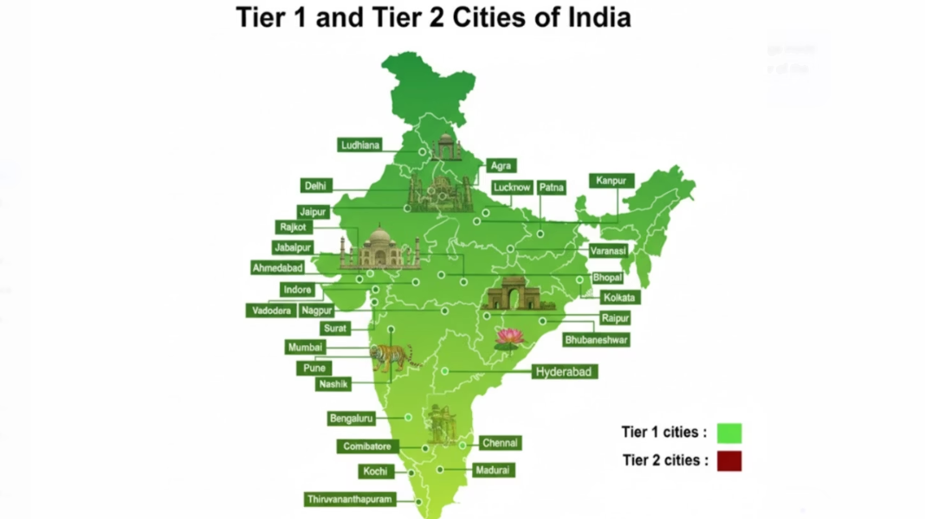
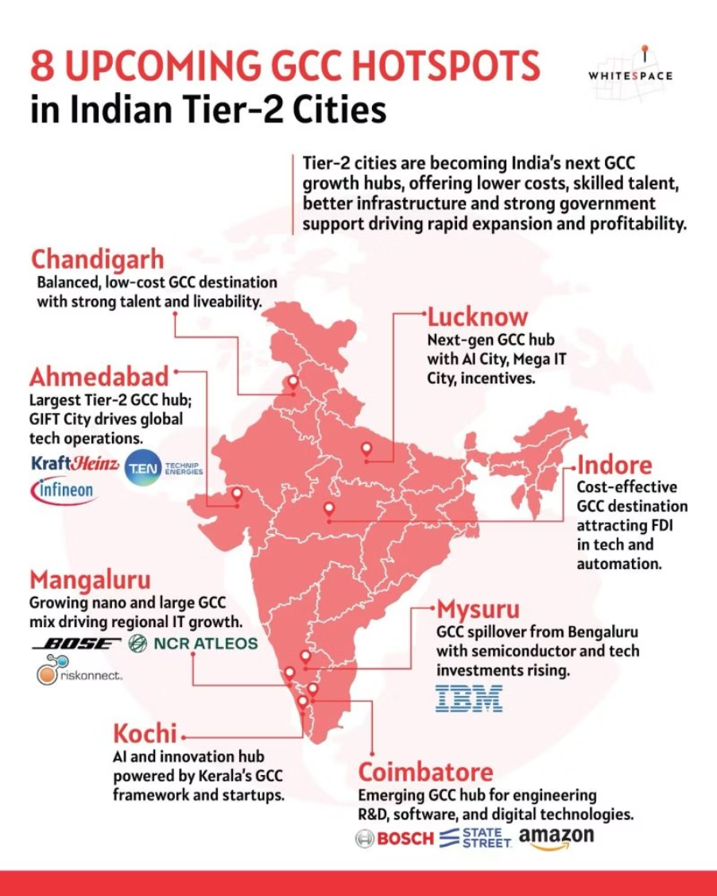
GCC Spread: Tier 1 & Tier 2 Cities of India
The geographic distribution of GCCs across India reflects both historical concentration patterns and emerging diversification trends. While traditional tech hubs continue to dominate, significant expansion into Tier-2 cities is reshaping the ecosystem landscape.
Distribution Across States and Cities
Emerging Tier-2 Presence
The visualization shows concentration in key metropolitan areas including Bengaluru, Hyderabad, Pune, Chennai, and the National Capital Region. These Tier-1 hubs account for approximately 70% of all GCC operations due to established infrastructure, talent availability, and ecosystem maturity.
Significant growth is occurring in Tier-2 cities including Coimbatore, Kochi, Jaipur, Vadodara, Ahmedabad, Chandigarh, and Visakhapatnam. These locations offer cost advantages, growing talent pools, improved infrastructure, and substantial state-level incentives driving expansion beyond traditional metros.
Geographic diversification creates both opportunities and challenges for transfer pricing compliance, requiring careful analysis of location-specific cost structures, talent availability impacts on functional profiles, and the application of state versus central tax incentives in ETR calculations.

Slide 32
GCC Incentive: State/City Comparison
State governments across India compete aggressively to attract GCC investments through comprehensive incentive packages. Understanding these incentives is critical for location decision-making and effective tax rate management under Pillar Two frameworks.
State / City
Key Incentives
Focus Areas / Strategic Positioning
Karnataka (Bengaluru)
100% stamp duty exemption
India's largest GCC hub; strong for AI, semiconductors, deep-tech, R&D, engineering. GCC Policy 2024–2029 is highly ambitious with comprehensive support framework.
50% rebate on land registration
Office space subsidies
Production-linked employment incentives
Electricity duty exemption
R&D & innovation grants
Fast-track approvals
Up to 40% CAPEX funding
Telangana (Hyderabad)
Power cost reimbursement
Fast-growing hub for engineering, AI, pharma, biotech, life-sciences GCCs. Strong government support and progressive policies.
100% stamp duty exemption
25% rental subsidy (first 3 years)
Capital subsidies
Support for night shifts, flexible labor
Best-in-class IT parks: T-Hub, Genome Valley
Tamil Nadu (Chennai, Coimbatore)
50–100% stamp duty exemption
Strong in auto-tech, BFSI, SaaS, electronics, manufacturing-led GCCs. Established ecosystem with diverse industry presence.
Skilling/training subsidies
Electricity tax exemption
Green-building incentives
Women workforce incentives
Special GCC packages in IT corridors

Slide 33
GCC Incentive: State/City Comparison (Continued)
State / City
Key Incentives
Focus Areas / Strategic Positioning
Maharashtra (Pune, Mumbai)
IT/ITES incentives
Top destination for engineering R&D, BFSI, fintech labs, automotive design. GCC Policy 2025–2030 emphasizes innovation and digital transformation.
Stamp duty exemption
Employment incentives (skill/wage-linked)
Fintech & BFSI innovation support
Government-built infrastructure
Gujarat – GIFT City (IFSC)
10-year 100% tax holiday under Section 80LA
India's fastest-growing financial services GCC hub: banking, insurance, trading, fund management. GCC Policy 2025–2030 with world-class regulatory framework.
No GST for offshore services
Foreign currency flexibility
No STT, CTT, stamp duty
Global workforce mobility
Uttar Pradesh (Noida)
Capital subsidies
IT/ITES, gaming, telecom, digital operations GCCs. Proximity to NCR with cost advantages.
100% stamp duty exemption
Extra incentives for large IT parks
Haryana (Gurugram)
IT/ITES incentives
GCC focus on BFSI, enterprise tech, digital ops, consulting support. Part of NCR ecosystem with strong connectivity.
Night-shift permissions for women
Rental / building subsidies
Andhra Pradesh
Training cost reimbursement
Suitable for BPO, IT services, shared services, digital operations GCCs. Emerging destination with growth potential.
Power tariff incentives
Plug-and-play IT parks

Slide 34
GCC Global Competitive Landscape
India faces competition from alternative GCC destinations, each offering distinct advantages. Understanding this competitive landscape is essential for strategic positioning and evaluating location-specific risks and opportunities.
Dimension
India
Poland
Philippines
UAE
Talent / Labor
Huge STEM talent pool, large English-speaking workforce, deep experience in GCC/IT/R&D
Highly educated workforce, good English, strong engineering talent in Central & Eastern Europe
Very strong BPO/customer-service talent, English proficiency, competitive wages
International workforce, high-quality talent especially in finance and IT, but more expensive in certain segments
Cost
Relatively low cost (labor + operations), strong value arbitrage for MNCs
Higher cost than India, but competitive vs Western Europe; good infrastructure
Very competitive for shared services/call centers
Higher cost, especially for office real estate, but offset by high-value operations, free zones, tax incentives
Tax / Incentives
Robust state-level GCC policies + central regime. In SEZs/IFSC, possible tax benefits
Attractive corporate tax (Poland's CIT ~19%), EU benefits, potential grants/subsidies, R&D incentives
PEZA zones: incentives such as tax holiday, reduced corporate rates, export-oriented incentives
Free zones (e.g., DIFC, ADGM) offer zero or reduced corporate tax, customs duty benefits, strong regulatory frameworks
Regulatory Risk
TP risk, PE risk, complex indirect tax (GST), but well-understood by MNCs
EU regulation, data protection rules (GDPR), regulatory compliance; stable legal system
Regulatory risk moderate, but compliance in labor, data, outsourcing needs management; currency risk
Regulatory ease in free zones is high; but cross-border tax planning (Pillar Two) and substance requirements matter

Slide 35
GCC Global Competitive Landscape (Continued)
Dimension
India
Poland
Philippines
UAE
Substance / Innovation Capability
Very good: R&D, centers of excellence, innovation hubs, IP creation capability
Strong for R&D, engineering, offshoring innovation
More for non-core operations (BPO/shared services), less for deep R&D (though evolving)
Excellent for regional headquarters, finance GCCs, in-house innovation; strong IP protection in some zones
Scalability & Time-Zone Advantage
Great for 24×7 operations, follow-the-sun models; strong ecosystem
Good for European operations, nearshore to Western Europe
Good for North America, APAC coverage; mature BPO ecosystem
Strong location for Middle East, Africa, Europe; GCC can serve regional HQ roles
Risk from Global Minimum Tax / TP
Significant — must model Pillar Two; TP complexity high
Also must manage Pillar Two; but stable EU tax framework, good planning possible
Might benefit from tax-incentive zones but must plan for substance; TP risk manageable
Free zones attractive, but substance and global top-up tax must be carefully designed; risk of ETR issues
Strategic Fit
Ideal for high-scale engineering, R&D, digital centers of excellence, shared services
Good for engineering CoEs, European support centers, R&D
Excellent for customer support, finance shared services, BPO-GCC
Ideal for regional HQ, finance CoEs, strategic innovation hubs, treasury/tax centers
India maintains significant competitive advantages in talent availability, cost structure, and innovation capability, but must actively manage transfer pricing complexity and Pillar Two implications to sustain its leadership position in the global GCC ecosystem.

Slide 36





Actionable Summary for GCC
Successful navigation of the evolving GCC tax landscape requires proactive, integrated strategies addressing transfer pricing compliance, Pillar Two implications, and regulatory requirements. The following action items represent critical priorities for GCC operators.
Run a GloBE / ETR Diagnostic
Reassess TP Policy Against DEMPE
Strengthen Documentation & Systems
Quantify India jurisdictional effective tax rate and top-up exposure under multiple scenarios incorporating state incentives and SEZ holidays. Conduct quarterly ETR checks, top-up tax simulations, and intercompany flow redesign analysis.
Where R&D/AI work occurs in India, test whether current cost-plus models reflect contribution to intangibles. Consider profit-split methodologies for residual returns when material DEMPE functions are performed in India.
Develop contemporaneous functional analysis and risk profiles, deliverables documentation, decision logs, and automated ETR/TP dashboards. Technology adoption and centralized reporting for Pillar Two is advisable.
Consider APAs / Pre-Filing for High Exposure
Plan for India QDMTT
If India introduces a QDMTT, it may reduce foreign top-up but could raise group tax in India. Model scenarios now and decide whether to claim QDMTT relief where permitted. Develop a country-by-country tracker to monitor implementation timing.
Advance Pricing Agreements remain a primary tool to lock in methodology and avoid future disputes. Prioritize APAs where DEMPE or profit-split issues are material or present high risk.

Slide 37

Thank You
CA Sharada Shetty
sharadashettykm@gmail.com

Slide 38
Appendix
Supporting Materials and Technical References
The following appendix sections provide detailed technical information, analytical frameworks, and reference materials supporting the core presentation content. These resources enable deeper exploration of specific topics and provide practical tools for implementation.
Government Incentives Detail
Maturity vs Risk Heatmap
Comprehensive breakdown of central and state-level incentive programs, eligibility criteria, and application processes
Framework for categorizing GCC functions by operational maturity and inherent risk to guide strategic positioning
QDMTT Readiness Assessment
Step-by-step methodology for evaluating Qualified Domestic Minimum Top-up Tax compliance readiness

Slide 39
Incentives Provided by Government
Central and state governments actively promote GCCs as catalysts for employment, digital innovation, and export-led services. Understanding the full spectrum of available incentives is essential for optimizing location decisions and managing effective tax rates.
Special Economic Zones (SEZ) Benefits
Proposed DESH Bill Framework
Grandfathered SEZ units (approved before 31 March 2020) still enjoy significant tax breaks, GST and duty exemptions, and simplified approvals. SEZs remain attractive as existing units retain these benefits for their full approved term, providing tax certainty and reduced compliance burden.
The Proposed DESH Bill—expected to replace the SEZ Act—aims to introduce flexible taxation, simplified compliance, and relaxed export/NFE norms, making the regime more service- and GCC-friendly. Overall, it is designed to remove rigid export conditions and enhance ease of doing business for global capability centers.
R&D Tax Incentives
Startup, AI, and Digital Incentive Schemes
ER&D and Innovation GCCs benefit from R&D deductions under Section 35, select weighted deductions, and a 10% Patent Box tax rate under Section 115BBF for patents developed and registered in India. These provisions significantly reduce effective tax rates for qualifying innovation activities.
GCC innovation labs benefit from national programs like Digital India, the National AI Mission, MeitY R&D funding, and indirectly from PLI schemes, supporting incubators and emerging technology development. These programs provide grants, subsidies, and ecosystem support for cutting-edge innovation.

Slide 40

QDMTT Readiness
Achieving Qualified Domestic Minimum Top-up Tax (QDMTT) compliance requires a structured approach. Organizations must assess current state, identify gaps, implement necessary changes, and establish ongoing monitoring processes.
Initial Assessment
Implementation Strategy
Understand QDMTT regulations and their applicability to your organization. Gather baseline data to identify affected entities, jurisdictions, and transactions. Map current tax positions and effective tax rates across all operating locations.
Develop a detailed action plan to address gaps, defining clear responsibilities, selecting appropriate technology solutions, establishing realistic timelines, and allocating necessary resources for achieving QDMTT compliance across the organization.
1
2
3
4
Gap Analysis
Ongoing Compliance
Compare current tax reporting processes and data infrastructure against QDMTT requirements. Pinpoint specific data gaps, process inadequacies, or system limitations. Quantify the impact of identified gaps on compliance capability and tax positions.
Establish continuous monitoring mechanisms for QDMTT adherence. This includes regular data validation, updating policies as regulations evolve, and ensuring systems generate required calculations, documentation, and reports on a sustained basis.

